Slide 1
code review table space checker for rdf import
Navigation
Shichao

Slide 2
content
table space checker for rdf import
background and target
problems
solution

Slide 3
tablespace checker for rdf import
background
rdf data
process of import
tablespace of postgres
error
with this process, space of database may not enough.
target
find out the information of database tablespace space, and check this problem at begin.
directory structure of rdf data
db

Slide 4
problems
troubles faces
find physical storage location of selected table space
find out the remaining space size
find this task need database space
solution
find out how many space remaining on database server
how many space this task need

Slide 5
solution
begin
Input
host
database name
table space
….
code structure
tablespace_checker
check_utils
1. parse command lines
2. judgement host is localhost
3. get remain size
4. other methods
get the need space size
db_model
is local
local space left
remote space left
remote_model
disk_size
config_reader
compare two size
end

Slide 6
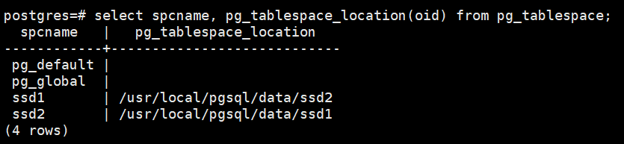
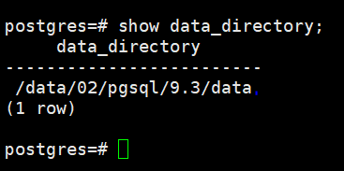
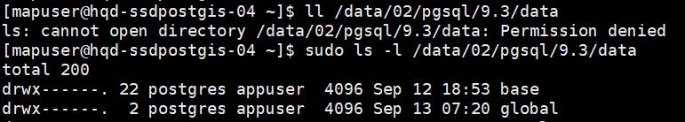
how to find physical storage location of selected table space
1 all table space list
2 base data location

Slide 7
find out the remaining space size
local
remote
find this task need database space
step 1: last version database, if possible return the size.
select pg_database_size(datanase_name);
step 2: if not, load this need space size from config file.
'hqd-ssdpostgis-04.mypna.com', 'hqd-ssdpostgis-05.mypna.com', "10.179.1.110", 'shd-dpc6x64ssd-02.china.telenav.com'
finally
space_left, space_need
return ( space_left > min( space_need*1.5, space_need+200G ) ? True : False )

Slide 8
Questions
Thanks

